Slide 1
CMPT 354: Database System I
Lecture 12. Where to go from here

Slide 2
Where are we now
How to query a database
SQL (Lec 3-4)
How to design a database
ER Model (Lec 8)
Design Theory (Lec 9)
Relational Model (Lec 2)
How to develop a database application
Database Application (Lec 10)
Transactions (Lec 11)
How to process a SQL query
Relational Algebra (Lec 5)
Query Processing (Lec 6)
Query Optimization (Lec 7)

Slide 3
Where to go from here
Data Warehouse
Parallel Databases
Big Data Processing
Cloud Databases

Slide 4
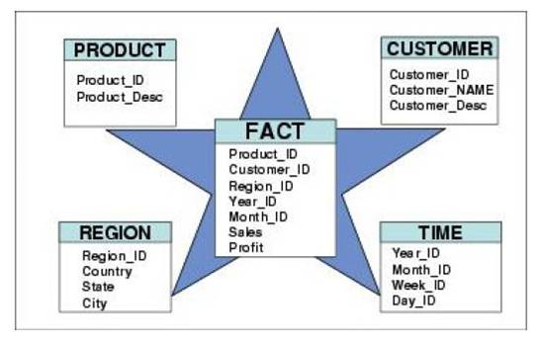
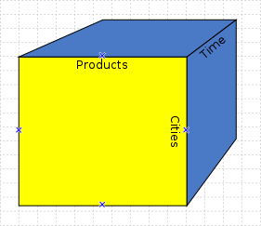
Sales
(Asia)
Data Warehouse
ETL
Collects and organizes historical data from multiple sources
Sales
(US)
ETL
ETL
Inventory
ETL
So far …
Star Schemas
Data cubes
Advertising

Slide 5
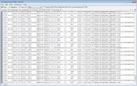

Sales
(Asia)
Data Warehouse
Sales
(US)
ETL
ETL
Collects and organizes historical data from multiple sources
Inventory
ETL
Advertising
ETL
ETL ?
How do we deal with semi-structured and unstructured data?
Do we really want to force a schema on load?
Text/Log Data
Photos & Videos
It is Terrible!

Slide 6
Sales
(Asia)
Data Warehouse
How do we clean and organize this data?
Sales
(US)
ETL
ETL
Collects and organizes historical data from multiple sources
Inventory
Depends on use …
ETL
Advertising
ETL
ETL ?
How do we deal with semi-structured and unstructured data?
Do we really want to force a schema on load?
How do we load and process this data in a relational system?
Text/Log Data
Depends on use …
Can be difficult ...
Requires thought ...
Photos & Videos
It is Terrible!

Slide 7

Data Warehouse
Sales
(Asia)
Data Lake
*
How do we clean and organize this data?
Sales
(US)
ETL
Store a copy of all the data
in one place
in its original “natural” form
Enable data consumers to choose how to transform and use data.
Schema on Read
ETL
Depends on use …
Inventory
ETL
Advertising
ETL
ETL ?
How do we load and process this data in a relation system?
Text/Log Data
Enabled by new Tools: Map-Reduce & Distributed Filesystems
Depends on use …
Can be difficult ...
Requires thought ...
Photos & Videos
What could go wrong?
It is Terrible!
*Still being defined…[Buzzword Disclaimer]

Slide 8
The Dark Side of Data Lakes
Cultural shift: Curate → Save Everything!
Noise begins to dominate signal
Limited data governance and planning
Example: hdfs://important/joseph_big_file3.csv_with_json
What does it contain?
When and who created it?
No cleaning and verification → lots of dirty data
New tools are more complex and old tools no longer work
Enter the data scientist

Slide 9
A Brighter Future for Data Lakes
Enter the data scientist
Data scientists bring new skills
Distributed data processing and cleaning
Machine learning, computer vision, and statistical sampling
Technologies are improving
SQL over large files
Self describing file formats & catalog managers
Organizations are evolving
Tracking data usage and file permissions
New job title: data engineers

Slide 10
Where to go from here
Data Warehouse
Parallel Databases
Big Data Processing
Cloud Databases

Slide 11
Why compute in parallel?
Multi-cores:
Most processors have multiple cores
This trend will likely increase in the future
Big data: too large to fit in main memory
Distributed query processing on 100x-1000x servers
Widely available now using cloud services

Slide 12
Parallel DBMSs
How to evaluate a parallel DBMS?
How to architect a parallel DBMS?
How to partition data in a parallel DBMS?

Slide 13
Parallel DBMSs
How to evaluate a parallel DBMS?
How to architect a parallel DBMS?
How to partition data in a parallel DBMS?

Slide 14
Performance Metrics for Parallel DBMSs
Nodes = processors, compute
Speedup
More nodes, same data → Higher speed
Scaleup
More nodes, more data → same speed

Slide 15
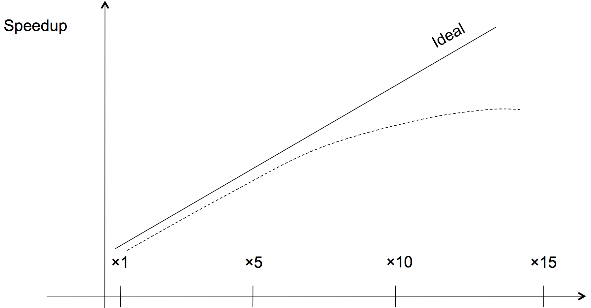
Linear v.s. Non-linear Speedup
# nodes

Slide 16
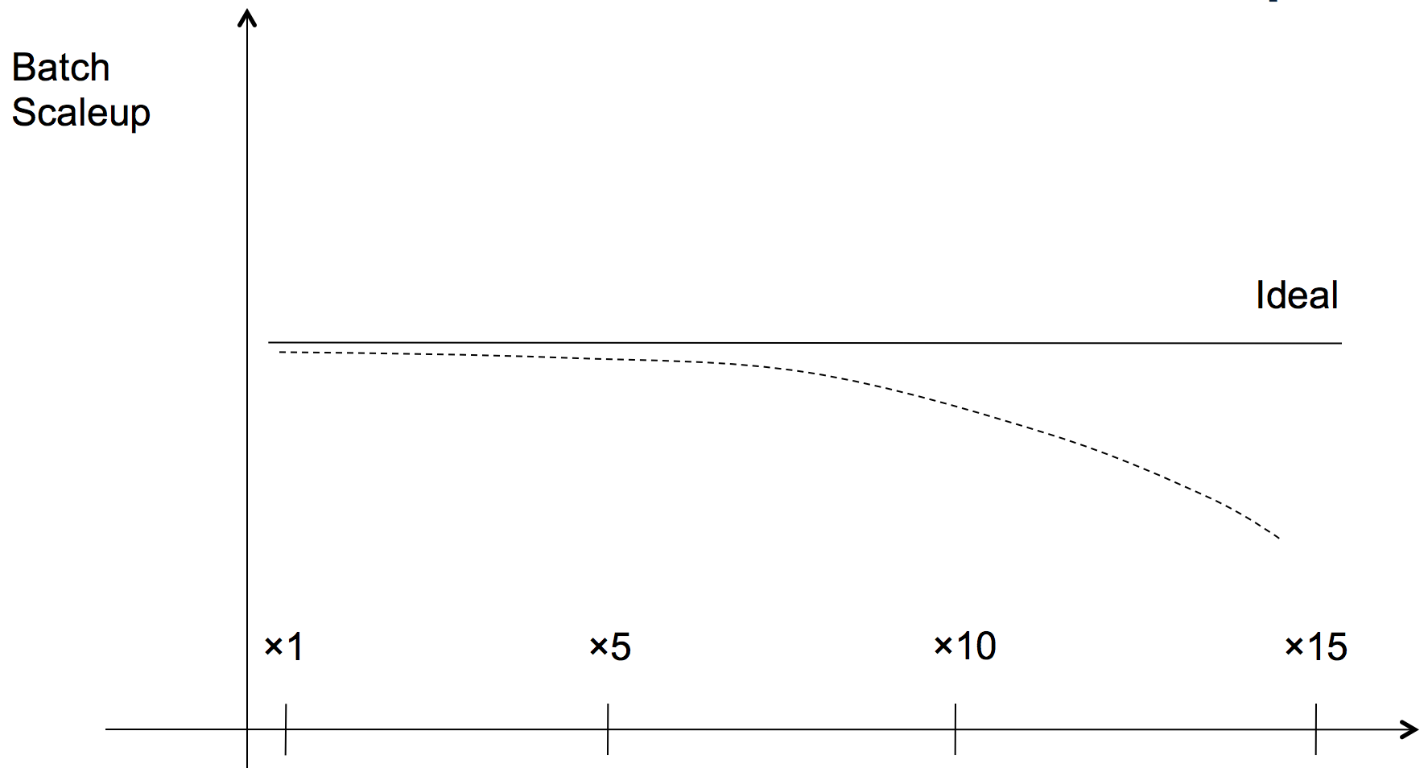
Linear v.s. Non-linear Scaleup
Scaleup
# nodes AND data size

Slide 17
Parallel DBMSs
How to evaluate a parallel DBMS?
How to architect a parallel DBMS?
How to partition data in a parallel DBMS?

Slide 18
Three Architectures
Shared Memory
Shared Nothing
Shared Disk

Slide 19
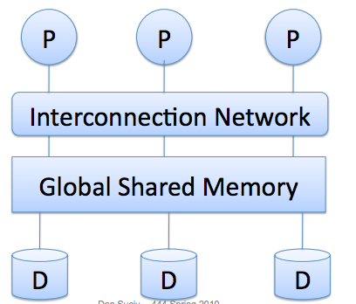
Shared Memory
GPU

Slide 20
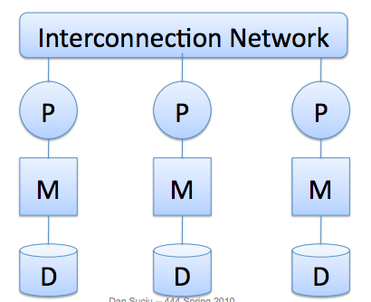
Shared Nothing
Parallel DBMSs, MapReduce,
Spark

Slide 21
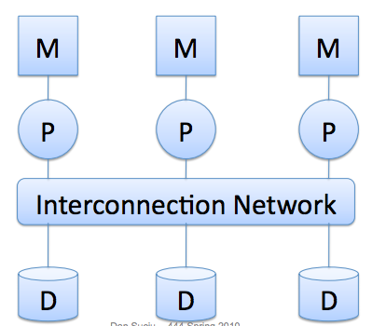
Shared Disk
Azure Data Warehouse

Slide 22
Three Architectures
Shared Memory
Shared Nothing
Shared Disk
Computation vs. Communication Trade-offs
Economic Consideration

Slide 23
Parallel DBMSs
How to evaluate a parallel DBMS?
How to architect a parallel DBMS?
How to partition data in a parallel DBMS?

Slide 24
Horizontal Data Partitioning
Round Robin
☺ Load Balancing
☹ Bad Query Performance
Range Partitioning
☺ Good for range/point queries
☹ Data Skew (i.e., Bad Load balancing)
Hash Partitioning
☺ Load Balancing, Good for point queries
☹ Hard to answer range queries

Slide 25
Where to go from here
Data Warehouse
Parallel Databases
Big Data Processing
Cloud Databases

Slide 26
3 Vs of Big Data
Volume: data size
Velocity: rate of data coming in
Variety: data sources, formats, workloads

Slide 27

Big Data Systems
Shared Nothing Architecture

Slide 28
How was Spark created?

Slide 29

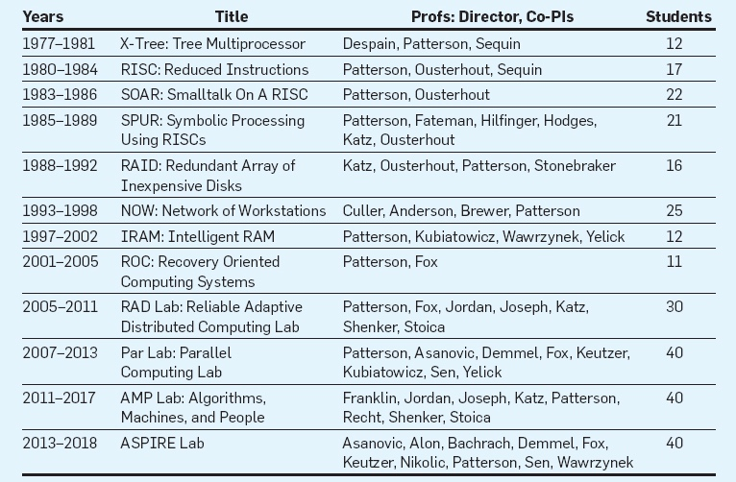
UC Berkeley’s Research Centers
David Patterson
Requirements
A common vision
About 5 years
At least three faculty
A dozen students

Slide 30
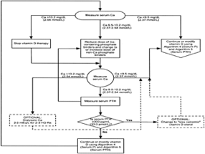
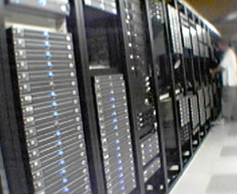

AMPLab’s Vision
Make sense of BIG DATA by tightly integrating algorithms, machines, and people
+
+

Slide 31
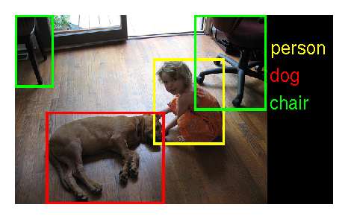
Example: Extract Value From Image Data
What are in the image?
How to solve the problem?
Deep Learning (Algorithms)
GPU Cluster (Machines)
ImageNet (People)

Slide 32

Spark’s Initial Idea
Algorithms + Machines
Run ML Algorithms on Hadoop
Why is it slow?
The algorithms are iterative (i.e., multiple scans of data)
MapReduce writes/reads data to/from disk at each iteration
Solution
Keep data in memory
Matei Zaharia

Slide 33
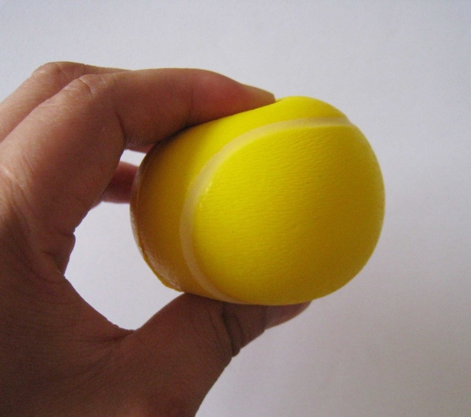
How About Fault Tolerance?
Resilient Distributed Datasets (RDD)
Main Idea: Logging the transformations (used to build an RDD) rather than the RDD itself
Zaharia et al. Resilient Distributed Datasets: A Fault-Tolerant Abstraction for In-Memory Cluster Computing. NSDI 2012: 15-28

Slide 34

Why Spark?
Fast
Easy to Use

Slide 35
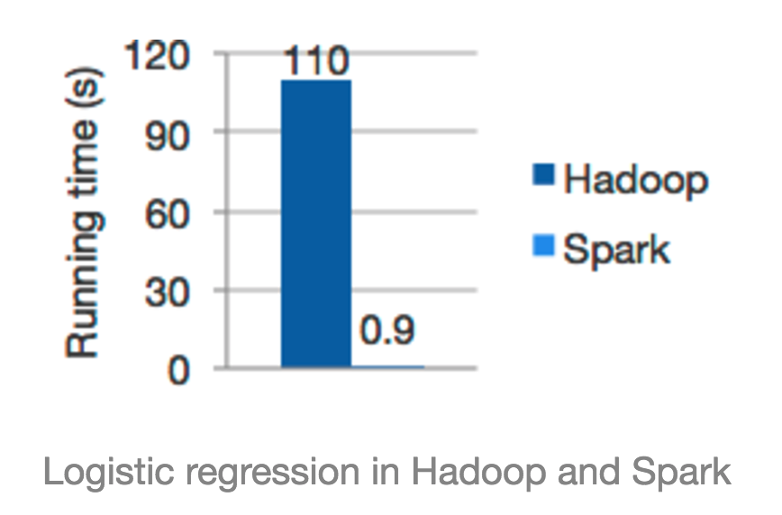
What Makes Spark Fast?
In-memory Computation
What you save?
Serialization/Deserialization
Compression/Decompression
I/O cost

Slide 36


“
”
CPU (and not I/O) is often the bottleneck
Ousterhout et al. Making Sense of Performance in Data Analytics Frameworks. NSDI 2015: 293-307

Slide 37
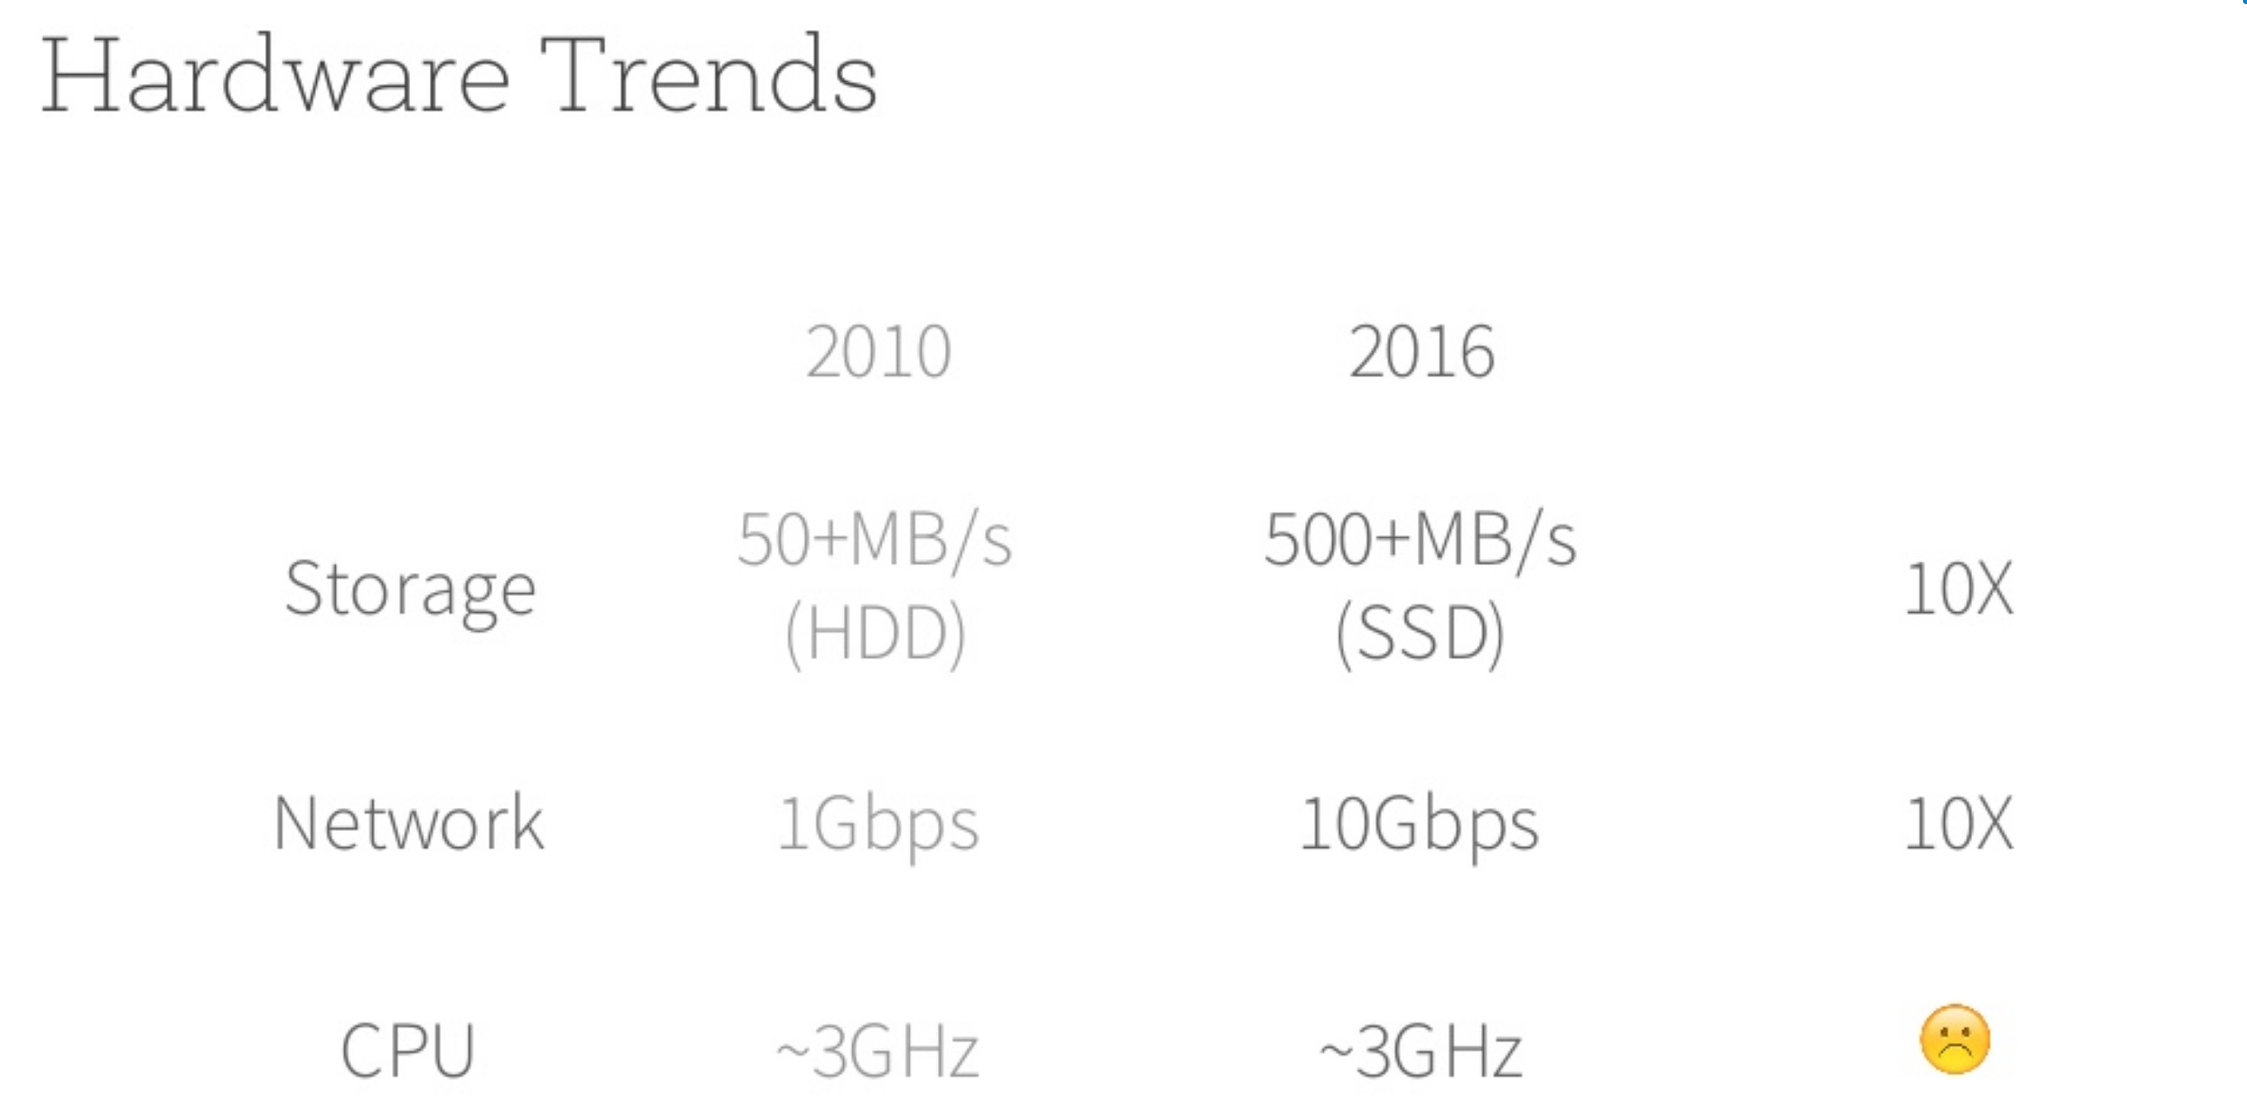

Slide 38
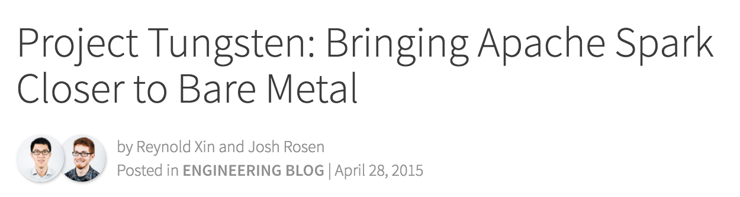
What Makes Spark Fast?
1. Memory Management and Binary Processing
2. Cache-aware computation
3. Code generation

Slide 39
Why Spark?
Fast
Easy to Use

Slide 40
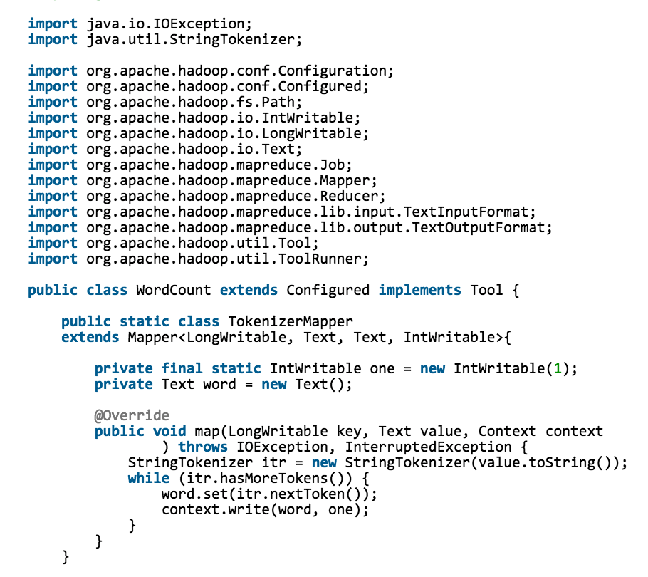
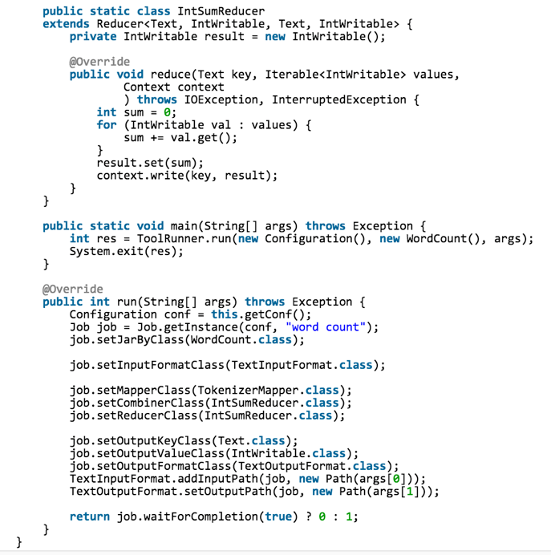
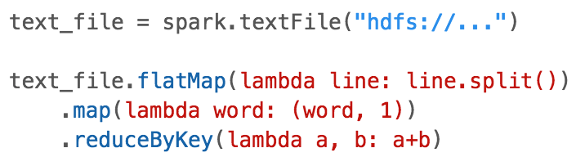
What Makes Spark Easy-to-Use?
Over 80 High-level Operators
WordCount (Mapreduce)
WordCount (Spark)

Slide 41
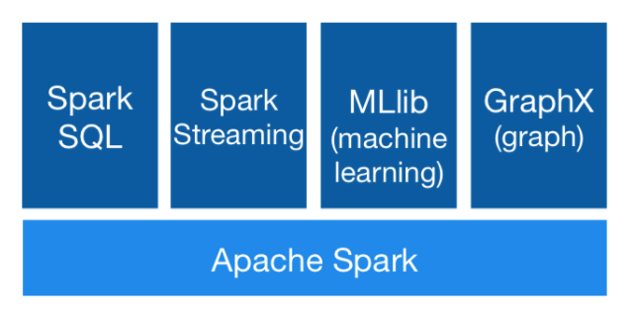
What Makes Spark Easy-to-Use?
Unified Engine
Easy to manage, learn, and combine functionality

Slide 42

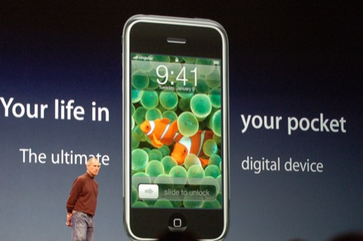
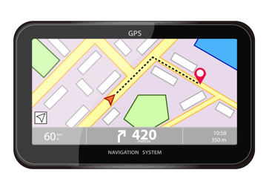



Analogy
Specialized Devices
Unified Device

Slide 43





















What Makes Spark Easy-to-Use?
Integrate Broadly
Languages:
The Big Data world is diversified
Data Sources:
Environments:

Slide 44
Where to go from here
Data Warehouse
Parallel Databases
Big Data Processing
Cloud Databases

Slide 45
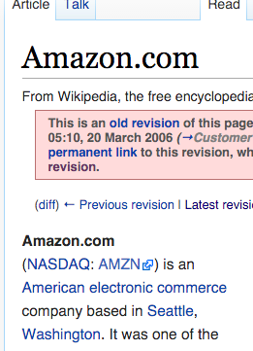
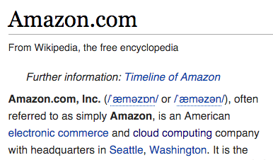
Amazon
From Wikipedia 2006
From Wikipedia 2016

Slide 46
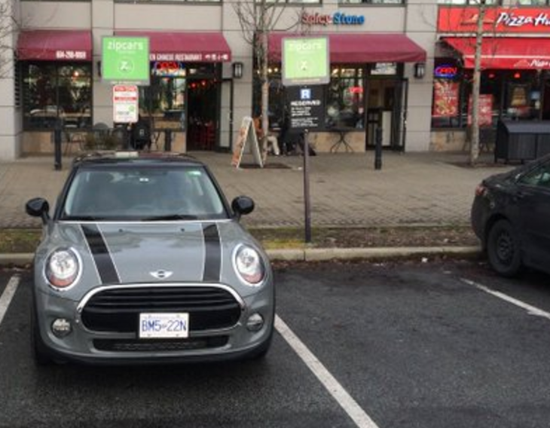
What is Cloud Computing?
The buzz word before “Big Data”
Larry Ellison’s response in 2009 (https://youtu.be/UOEFXaWHppE?t=7s)
Berkeley RADLab’s paper in 2009 (https://youtu.be/IJCxqoh5ep4)
A technical point of view
Internet-based computing (i.e., computers attached to network)
A business-model point of view
Pay-as-you-go (i.e., rental)

Slide 47
Three Types of Cloud Computing
CourSys
Application
+ Cloud = SaaS (Software as a service)
Database
Platform
+ Cloud = PaaS (Platform as a service)
Servers
Infrastructure
+ Cloud = IaaS (Infrastructure as a service)

Slide 48
Cloud Databases
Amazon
Aurora
Redshift
Microsoft
Azure SQL Server
Azure SQL Data Warehouse
Google
Spanner
BigQuery

Slide 49
Summary
Data Warehouse
Parallel Databases
Big Data Processing
Cloud Databases

Slide 50
Acknowledge
Some lecture slides were copied from or inspired by the following course materials
“W4111: Introduction to databases” by Eugene Wu at Columbia University
“CSE344: Introduction to Data Management” by Dan Suciu at University of Washington
“CMPT354: Database System I” by John Edgar at Simon Fraser University
“CS186: Introduction to Database Systems” by Joe Hellerstein at UC Berkeley
“CS145: Introduction to Databases” by Peter Bailis at Stanford
“CS 348: Introduction to Database Management” by Grant Weddell at University of Waterloo
UC Berkeley DS100 Fall 2017

